Slide 1

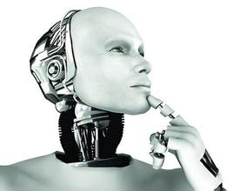
文本分类
陈海斌
Lab of Machine Learning and Data Mining
South China University of Technology

Slide 2
Outline
Part1 传统文本分类、TFIDF
Part2 深度学习基础模型
浅层语义建模：
·类传统方法：fastText
·字符级别：char-CNN
深层语义建模：
·词向量：TextRCNN
·分层attention：HierAtteNet
·Seq2SeqAttn、Transformer
Part3 SGM:Sequence Generation Model for Multi-Label Classification[COLING 2018 best papers]

Slide 3
Part1 传统文本分类
文本预处理：分词、停用词、词语替换
文本表示：词袋模型/向量空间模型:( 0, 0, 0, 0, .... , 1, ... 0, 0, 0, 0)
特征提取：tfidf、mi、lsa
基于语义的文本表示：LDA(Latent Dirichlet Allocation) 贝叶斯模型
分类器：lr、svm
数据稀疏和维度爆炸：
人工降维：停用词过滤，低频n-gram过滤等
自动降维：LDA(Linear Discriminant Analysis)

Slide 4
Part1 TFIDF
计算词频：
考虑到文章有长短之分，为了便于不同文章的比较，进行"词频"标准化：
计算逆文档频率：
计算TF-IDF：

Slide 5
Part1 TFIDF
TFIDF其他可调整参数：
token_pattern：正则表达式分词(最短长度)
max_df/min_df: 按频率过滤词语
stop_words: 停用词
ngram_range: n-gram上限与下限

Slide 6
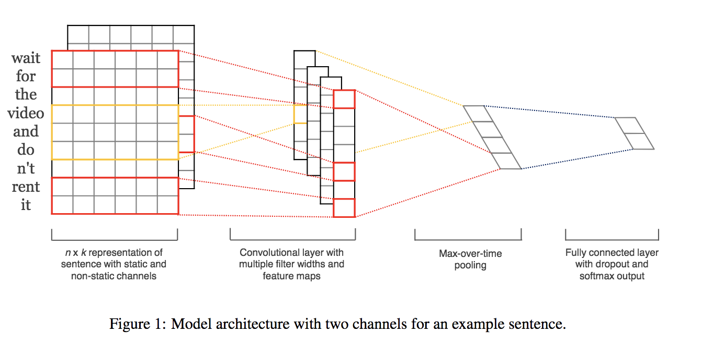
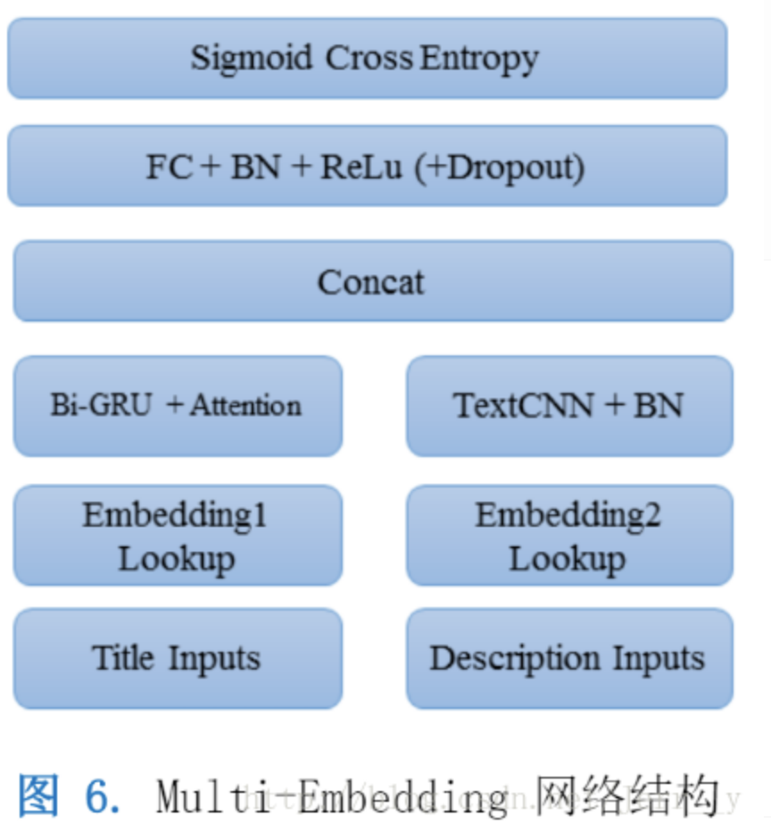
Part2 Text-CNN
(dynamic) k-max pooling…
e.g.我觉得这个地方景色还不错，但是人也实在太多了
Convolutional Neural Networks forSentence Classification (EMNLP 2014)

Slide 7
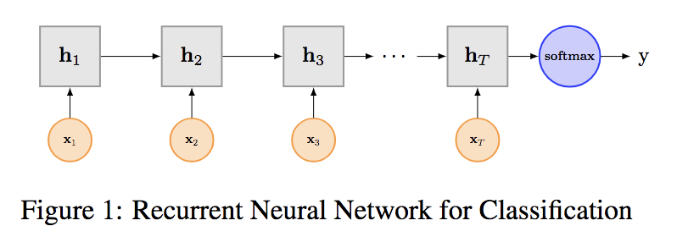
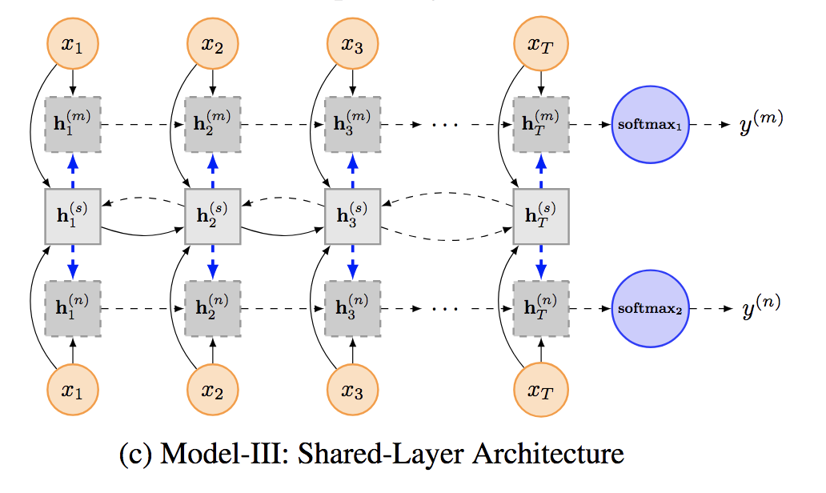
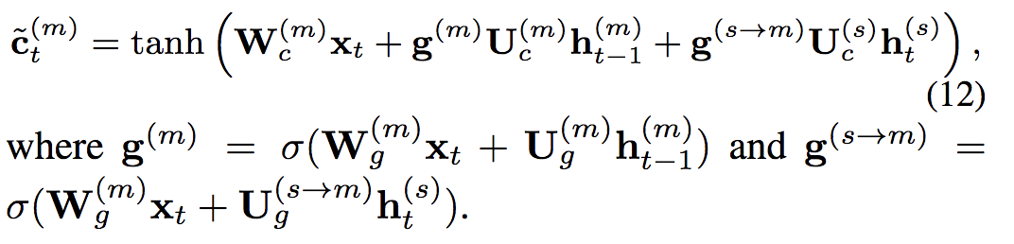
Part2 Text-RNN
Recurrent Neural Network for Text Classification with Multi-Task Learning(IJCAI 2016)

Slide 8
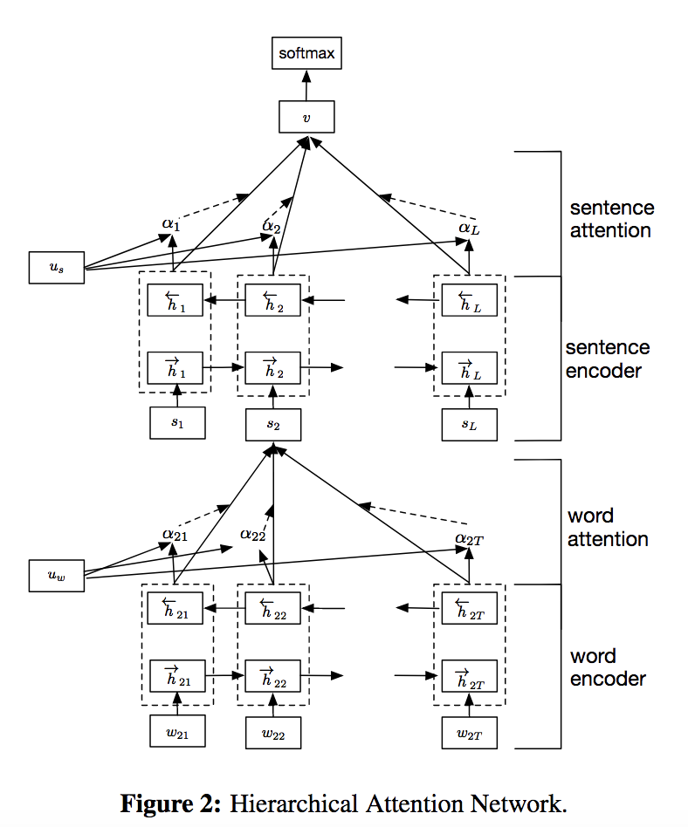
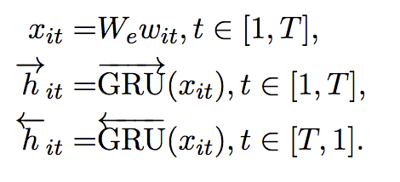
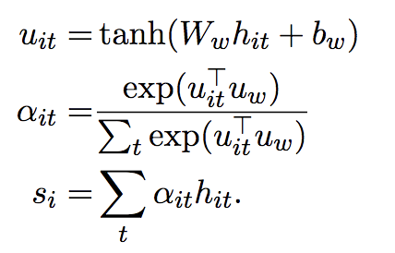
Part2 Text-RNN+attention
Word encoder
Word attention
Hierarchical Attention Networks for Document Classification(2016ACL)

Slide 9
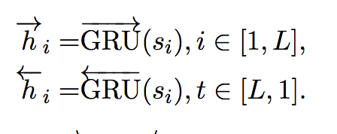
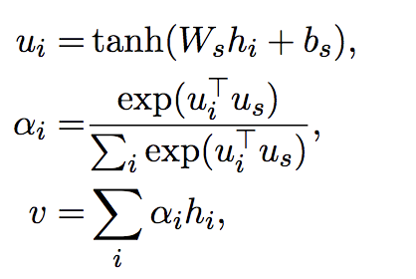
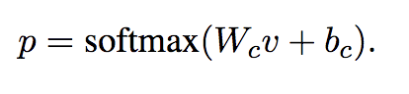
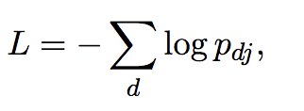
Part2 Text-RNN+attention
sentence encoder
sentence attention
document classification
Hierarchical Attention Networks for Document Classification(2016ACL)

Slide 10
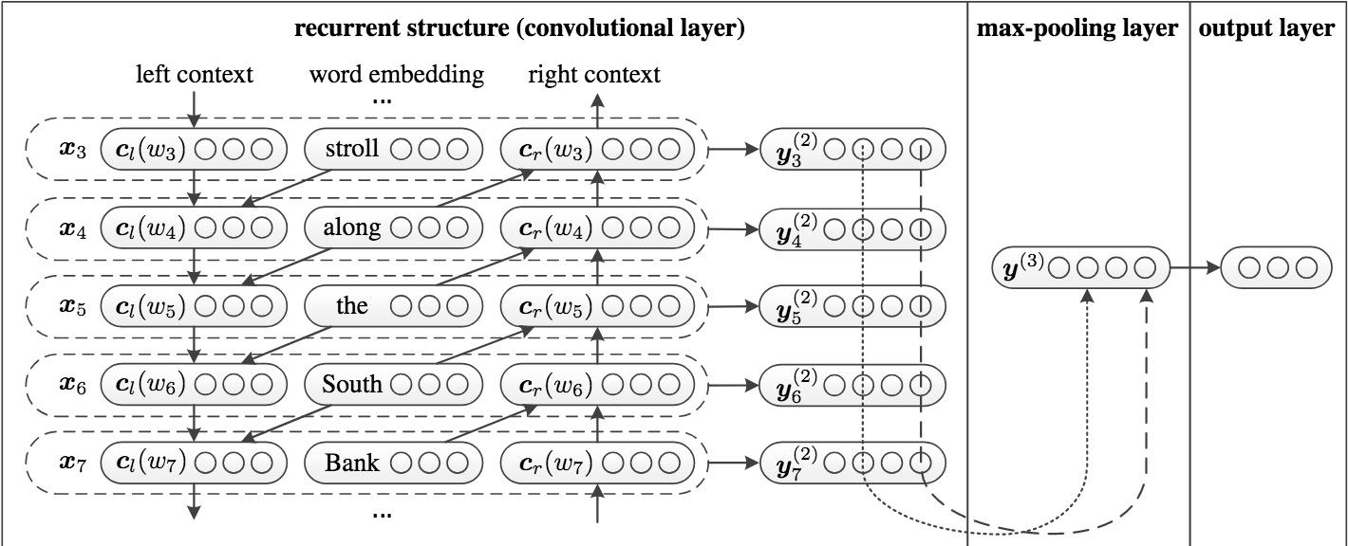
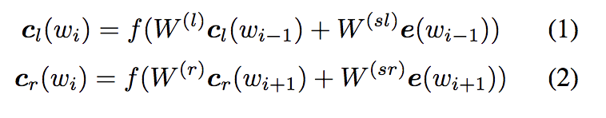
Part2 Text-RCNN
e: word embedding
W(sl): combine the semantic of the current word
W(l): transform the hidden layer into the next hidden layer
f: non-linear similar function
Recurrent Convolutional Neural Networks for Text Classification(2015AAAI)

Slide 11
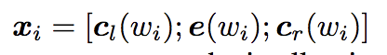
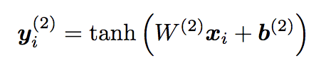
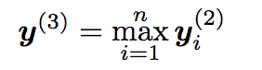
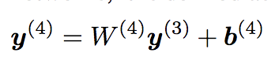
Part2 Text-RCNN
Recurrent Convolutional Neural Networks for Text Classification(2015AAAI)

Slide 12
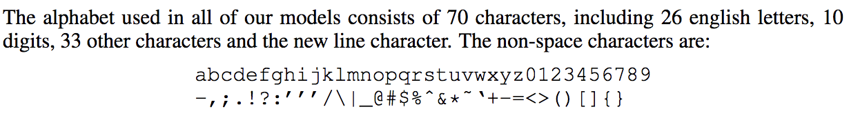
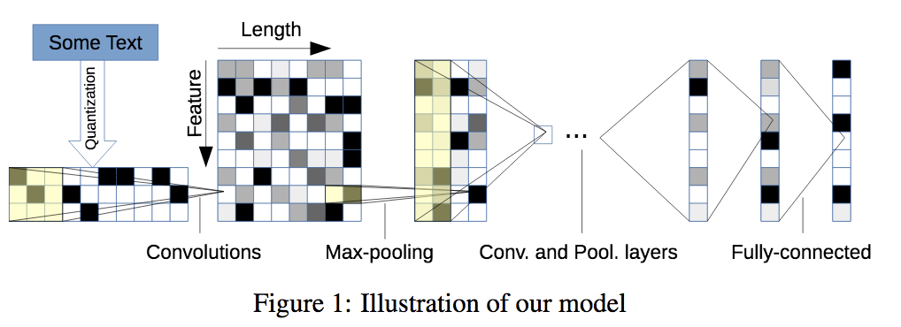
Part2 char-CNN
用户生成数据不规范（拼写错误，表情符号）
不需要预训练词向量
无词法/句法信息
大规模训练集或应用场景
6层卷积、3层全连接层(带dropout)
Character-level Convolutional Networks for Text Classification(2015NIPS)

Slide 13
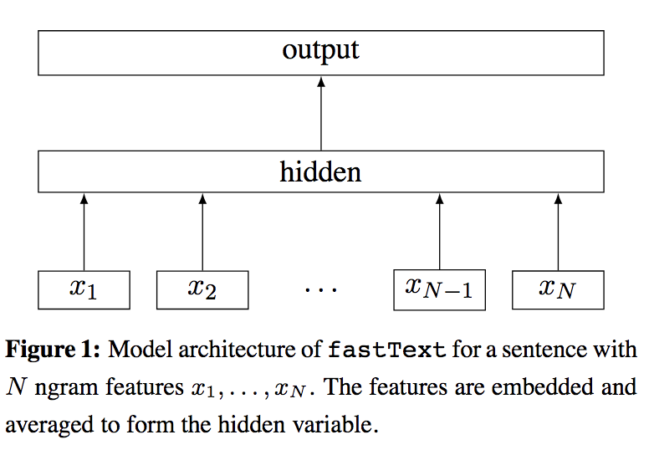
Part2 FastText
fastText 预测标签，而 CBOW 模型预测中间词。
Bag of Tricks for Efficient Text Classification(EACL 2017)

Slide 14
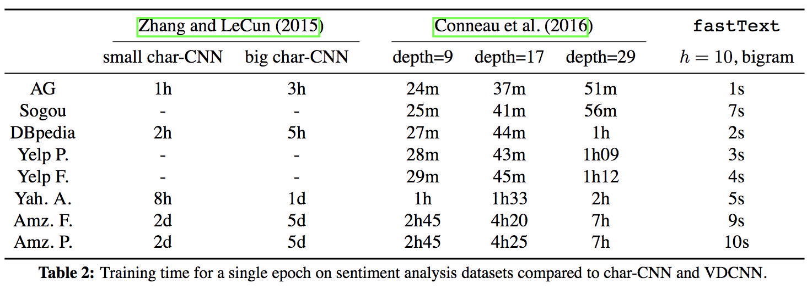
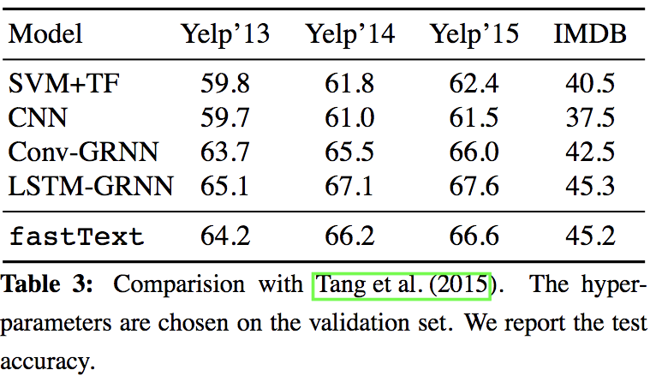
Part2 FastText
Bag of Tricks for Efficient Text Classification(EACL 2017)

Slide 15
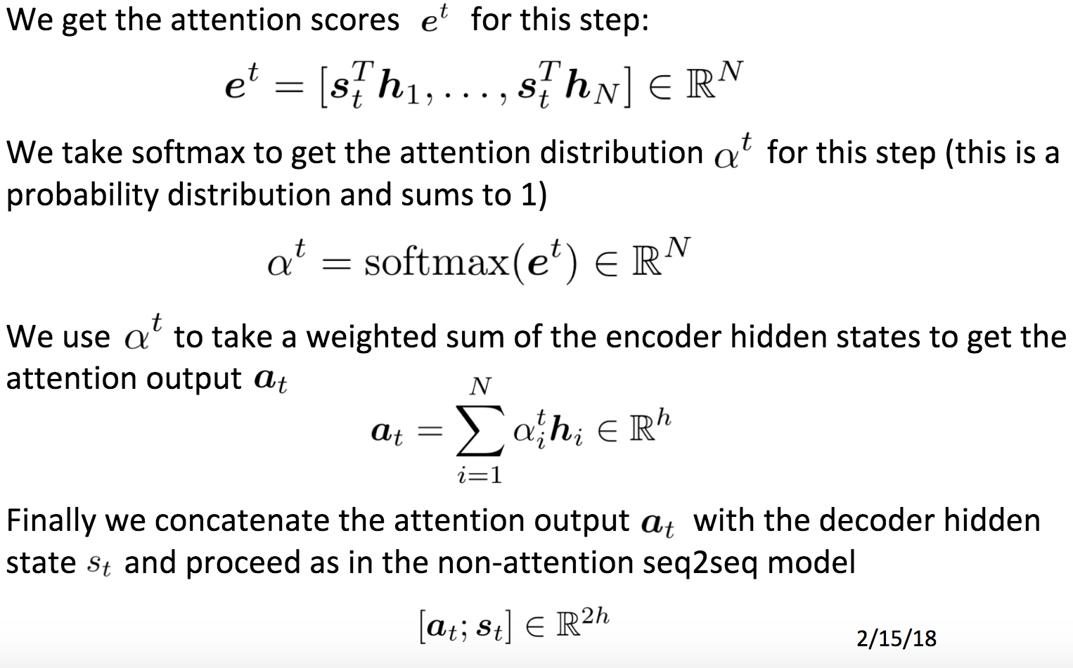
Part2 Seq2SeqAtte

Slide 16
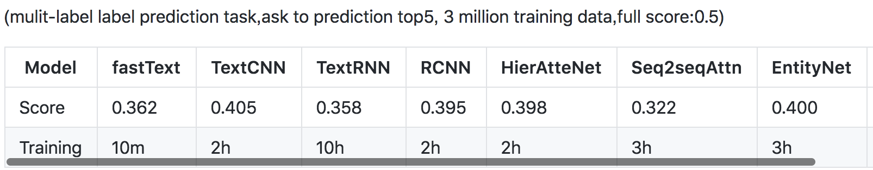
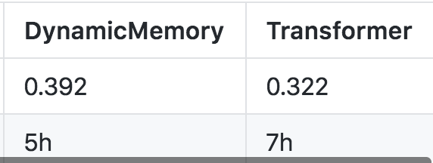
Part2 深度学习基础模型
架构上不严谨的分类：
·类传统方法：fastText
·字符级别：char-CNN(这两个为浅层语义建模)
·词向量：TextRCNN
·分层attention：HierAtteNet
·Seq2SeqAttn、Transformer

Slide 17
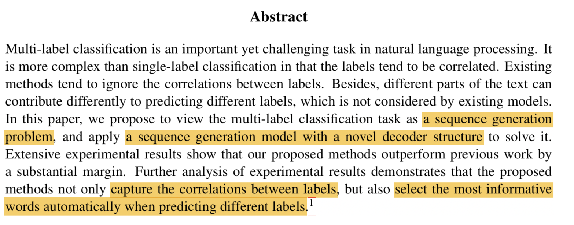
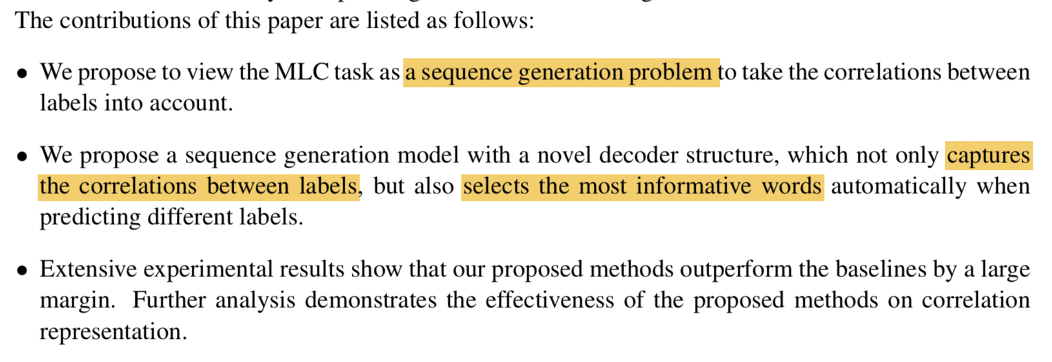
Part3 SGM:Sequence Generation Model for Multi-Label Classification[COLING 2018 best papers]
多标签问题：横向与纵向
x = (w1, w2, …, wm) 为句子长度为m个词的句子序列 
L = {l1, l2, … , lL} 是所有的标签
针对句子序列x有n个标签，这n个标签的集合为y 且有 y ⊂ L
工业界：BR: multiple single-label classification

Slide 18
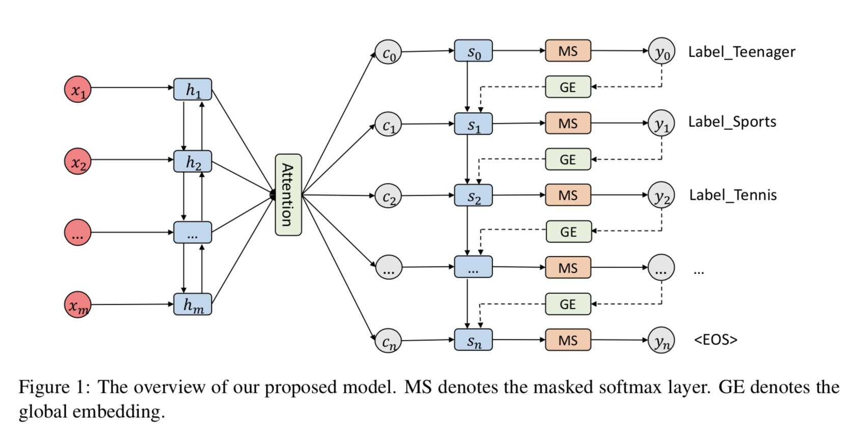
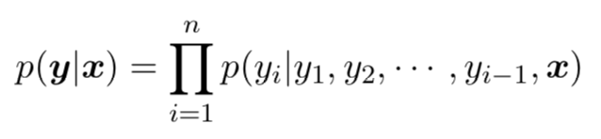
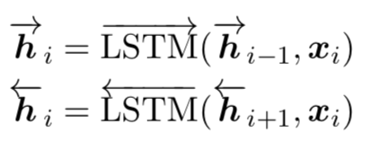
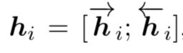
Part3 SGM:Sequence Generation Model for Multi-Label Classification[COLING 2018 best papers]
Model：
finding an optimal label sequence y∗ that maximizes the conditional probability p(y|x)
Sort the label according to the frequency
Encoder

Slide 19
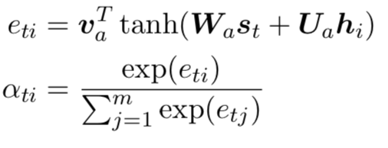
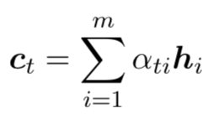
Part3 SGM:Sequence Generation Model for Multi-Label Classification[COLING 2018 best papers]
Model：
Attention：
produce a context vector by focusing on different portions of the text sequence and aggregating the hidden representations of those informative words
Wa, Ua, va are weight parameters and st is the current hidden state of the decoder at time-step t

Slide 20
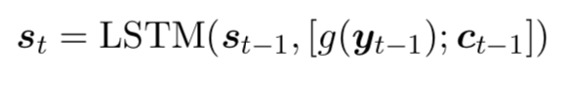
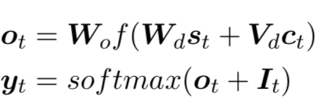
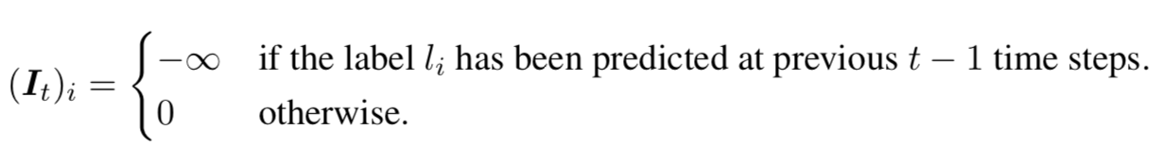
Part3 SGM:Sequence Generation Model for Multi-Label Classification[COLING 2018 best papers]
Model：
Decoder:
[]:concat g(yt−1) :embedding
Wo, Wd, and Vd :weight parameters, It :mask vector
loss function: cross-entropy loss function
beam search: find the top-ranked prediction path at inference time

Slide 21
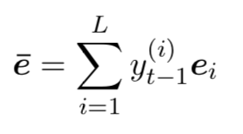
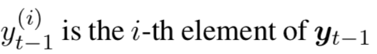
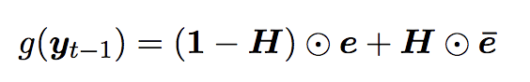
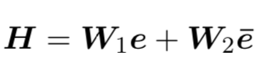
Part3 SGM:Sequence Generation Model for Multi-Label Classification[COLING 2018 best papers]
Model：
Global embeddings
exposure bia: get a succession of wrong label predictions (beam search)
Highway network--transform gate (2015)

Slide 22
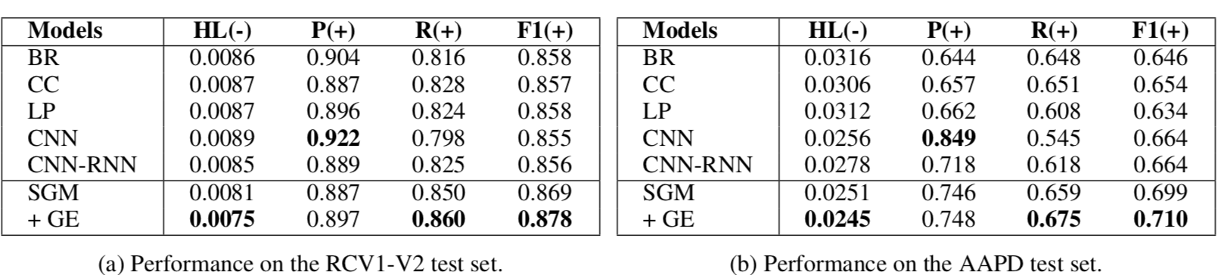
Part3 SGM:Sequence Generation Model for Multi-Label Classification[COLING 2018 best papers]

Slide 23
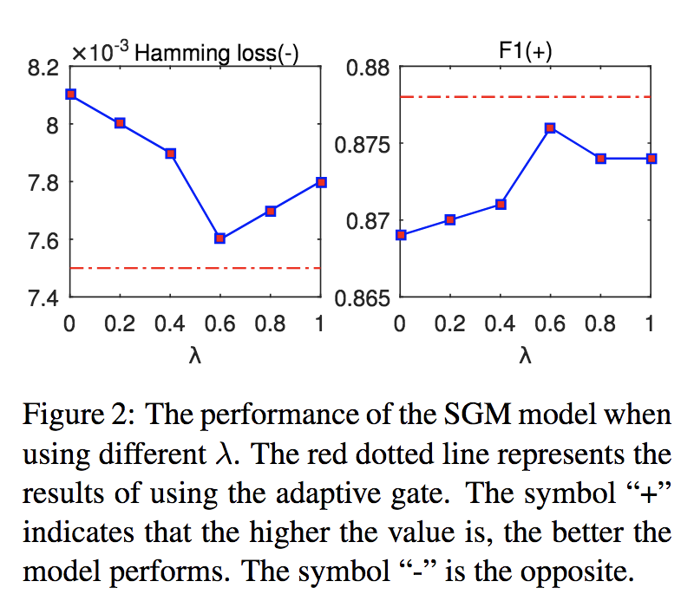
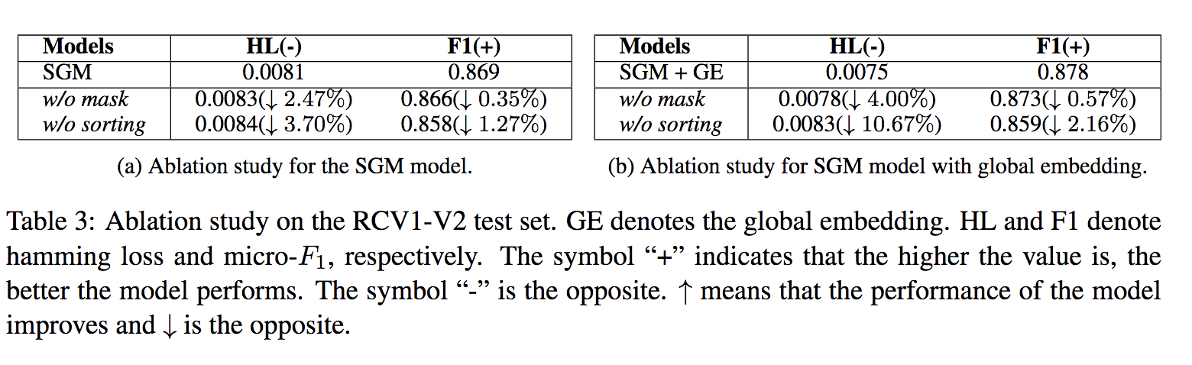
Part3 SGM:Sequence Generation Model for Multi-Label Classification[COLING 2018 best papers]
Analysis and Discussion：
Transform gate
Mask and sorting：

Slide 24
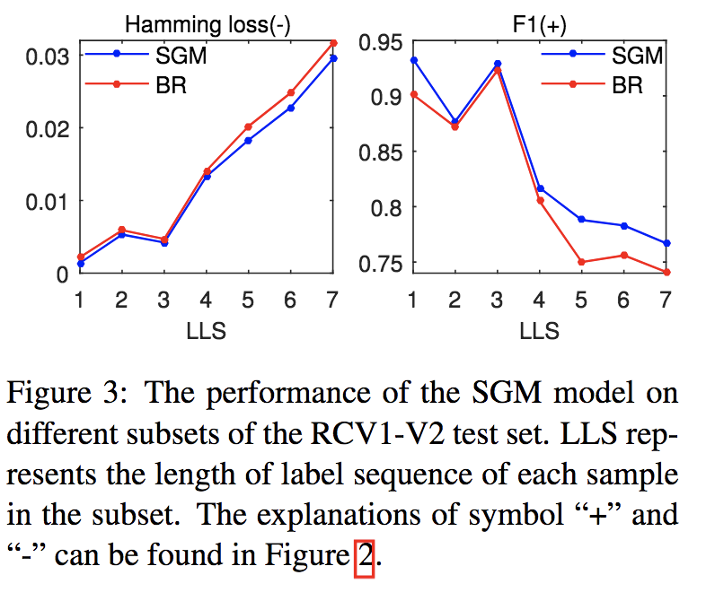
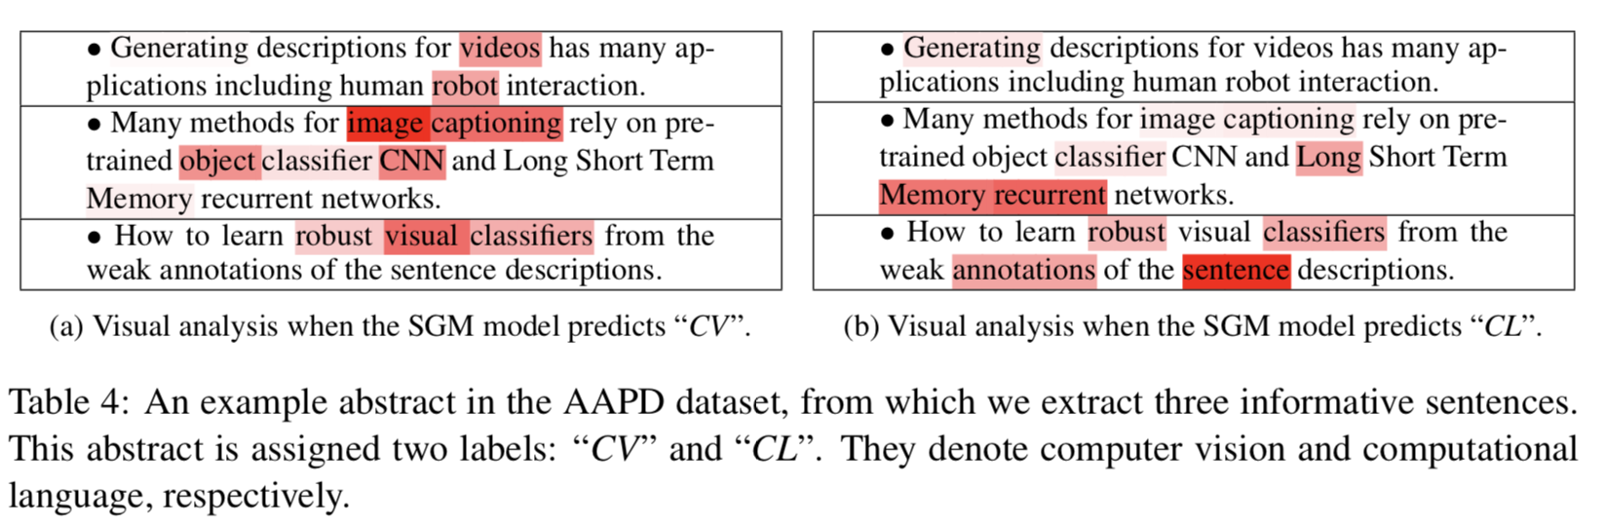
Part3 SGM:Sequence Generation Model for Multi-Label Classification[COLING 2018 best papers]
Number of label
BR: multiple single-label classification
Visualization of Attention
CL：Computational Linguistics
CV：Computer Vision

Slide 25
Part3 SGM:Sequence Generation Model for Multi-Label Classification[COLING 2018 best papers]
Future work：
1. select the most informative words automatically when predicting different labels
2. a large number of labels

Slide 26
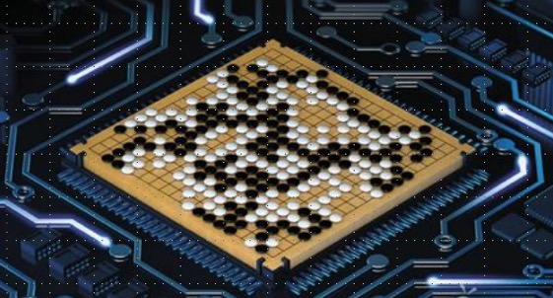
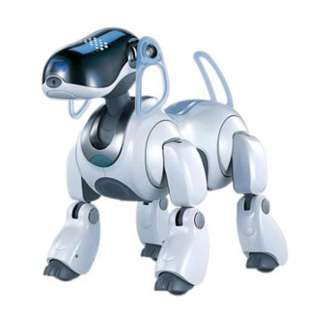
Thanks for your listening ...

